Slide 1
Privacy, Security, and Ethics
7
Chapter 7

Slide 2
Learning Objectives
Describe the impact of large databases, private networks, the Internet, and the web on privacy.
Discuss online identity and the major laws on privacy.
Discuss cybercrimes, including identity theft, Internet scams, data manipulation, ransomware, and denial of service.
Describe social engineering and malicious software, including crackers, malware, viruses, worms, and Trojan horses.
Discuss malicious hardware, including zombies, botnets, rogue Wi-Fi networks, and infected USB flash drives.
Detail ways to protect computer security, including restricting access, encrypting data anticipating disasters, and preventing data loss.
Discuss computer ethics, including copyright law, software piracy, digital rights
management, the Digital Millennium Copyright Act, as well as cyberbullying, plagiarism, and ways to identify plagiarism.

Slide 3

Introduction
What are the consequences of the widespread presence of this technology? Does technology make it easy for others to invade our personal privacy? When we apply for a loan or for a driver’s license, or when we check out at the supermarket, is that information about us being distributed and used without our permission? When we use the web, is information about us being collected and shared with others? How can criminals use this information for ransom, blackmail, or vandalism?
This chapter covers issues related to the impact of technology on people and how to protect ourselves on the Web.

Slide 4

People
Technology has had a very positive impact on people, but some of the impact could be negative.
Most significant concerns:
Privacy – What are the threats to personal privacy and how can we protect ourselves?
Security – How can access to sensitive information be controlled and how can we secure hardware and software?
Ethics – How do the actions of individual users and companies affect society?
Notes:
Information systems consist of people, procedures, software, hardware, data and the Internet.
Negative impact concerns:
Privacy
Security
Ethics

Slide 5
Privacy
Privacy – concerns the collection and use of data about individuals
Three primary privacy issues:
Accuracy – responsibility of those who collect data
Must be secure and correct
Property – who owns data and who has rights to software
Access – responsibility of those who control data and use of data
Notes:
Privacy (key term) concerns the collection and use of data about individuals
Accuracy (key term) – responsibility of those who collect data
Secure
Correct
Property (key term) – who owns data and who has rights to software
Access (key term) – responsibility of those who control data and use of data

Slide 6
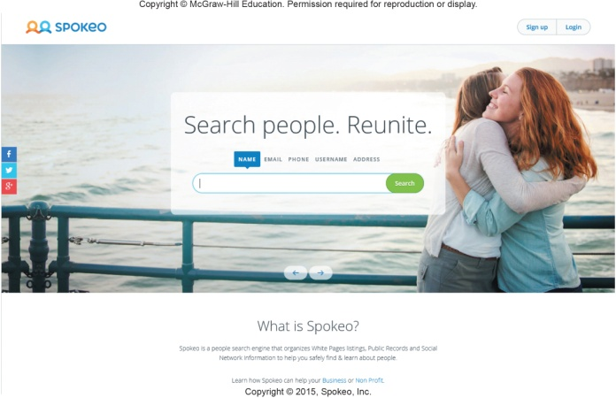
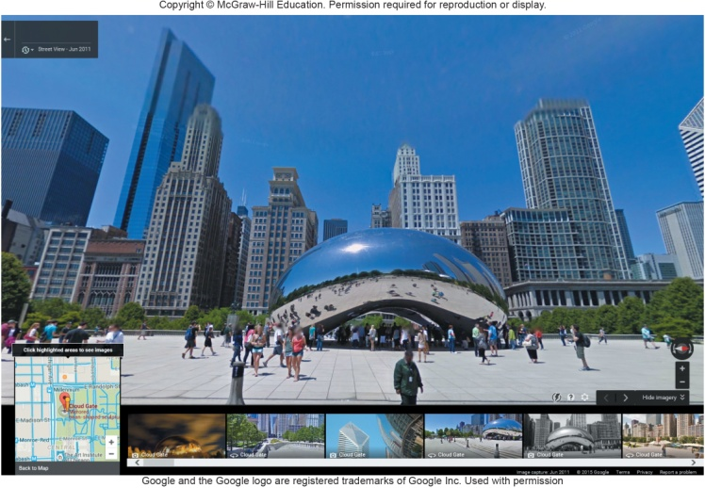
Large Databases / Big Data
Large organizations compile information about us daily
Big Data is exploding and ever-growing
The federal government alone has over 2000 database
Data collectors include
Government agencies
Telephone companies
Credit card companies
Supermarket scanners
Financial institutions
Search engines
Social networking sites
Information Resellers/Brokers
Collect and sell personal data
Create electronic profiles
Notes:
Big data (key term) ever growing volume of data
Data collected and stored on citizens every day
Collectors include
Government agencies
Telephone companies
Credit card companies
Supermarket scanners
Financial institutions
Search engines
Social networking sites
Information resellers (key term) or information brokers (key term) collects and sells personal data. The create electronic profiles (key term)

Slide 7
Large Databases / Big Data (Cont.)
Personal information is a marketable commodity, which raises many issues:
Collecting public, but personally identifying information (e.g., Google’s Street View)
Spreading information without personal consent, leading to identity theft
Spreading inaccurate information
Mistaken identity
Freedom of Information Act
Entitlement to look at your records held by government agencies
Notes:
Concerns include:
Spreading information without consent – example: collecting your shopping habits and sharing; or medical records, or driver’s license number
Last year over 10 million people were victimized by identity theft (key term) (illegal assumption of someone’s identity for economic gain)
Spreading inaccurate information – once you are tagged that photo can become a part of your electronic profile
Mistaken Identity (key term) – an electronic profile of one person is switched with another
Under the Freedom of Information Act (key term) you are entitled to look at your records held by government agencies.

Slide 8
Private Networks
Employee monitoring software
Employers can monitor e-mail legally
A proposed law could prohibit this type of electronic monitoring or at least require the employer to notify the employee first

Slide 9
The Internet and the Web
Illusion of anonymity
People are not concerned about privacy when surfing the Internet or when sending e-mail
When browsing the web, critical information is stored on the hard drive in these locations:
History Files
Temporary Internet Files
Browser cache
Cookies
First-party cookie
Third-party cookie
Privacy Mode
Web bugs
Spyware
Notes:
Illusion of anonymity (key term) -that if you are on the Internet and selective about disclosing names or other personal information that no one knows who you are or how to “find” you - false

Slide 10
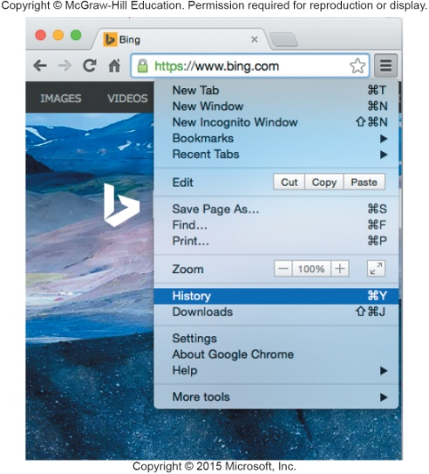
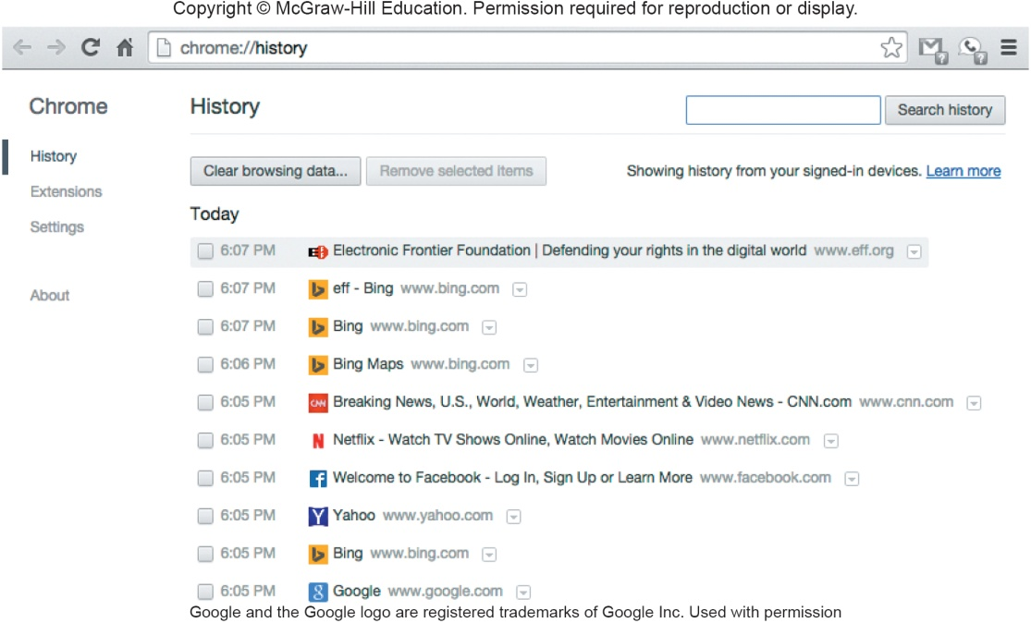
History Files and Temporary Internet Files
History Files
Include locations or addresses of sites you have recently visited
Temporary Internet Files / Browser Cache
Saved files from visited websites
Offers quick re-display when you return to the site

Slide 11
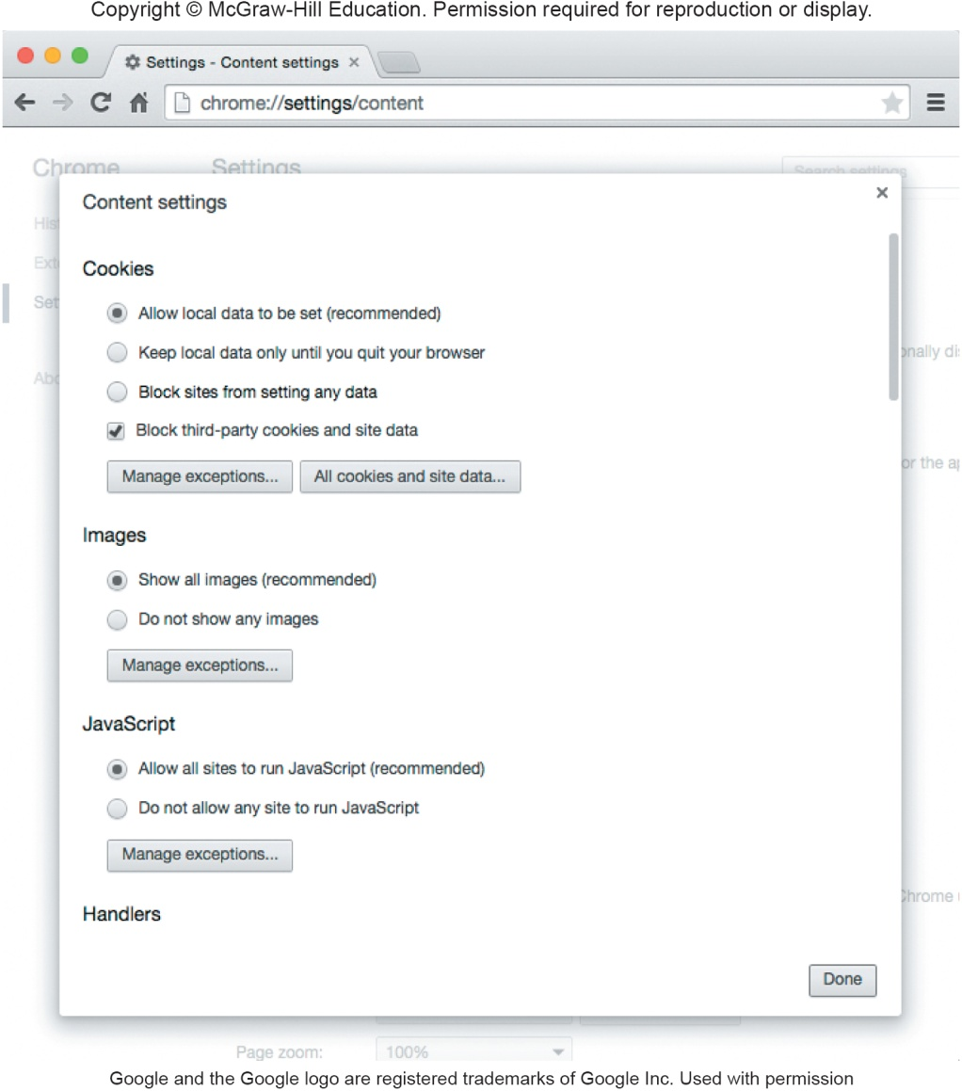
Cookies
Cookies are small data files that are deposited on your hard disk from web sites you have visited
First-party cookies are generated only by websites you are visiting
Third-party cookies are generated by an advertising company that is affiliated with the website
Also known as tracking cookies that keep track of your Internet activities through 3rd party cookies
Refer to the accompanying graphic displaying how to block 3rd party cookies
Notes:
Two basic types of cookies(key term)
Most cookies are harmless and are intended to provide customized service
First party cookies (key term) are generated by the website you are currently visiting.
Third party cookies (key term) are generated by an advertising company that is affiliated with the website you are visiting. Often referred to as tracking cookies (key term)

Slide 12
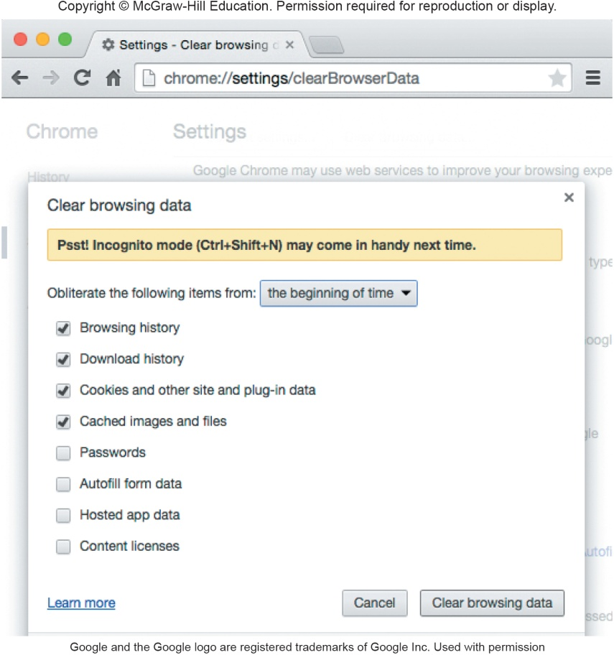
Privacy Modes
Ensures your browsing activity is not recorded on your hard drive
Incognito Mode
Google Chrome
Private Browsing
Safari
Notes:
Privacy mode (key term) eliminates history files as well as blocks most cookies.
InPrivate Browsing (key term) privacy mode for Internet Explorer
Private Browsing (key term) privacy mode for Safari

Slide 13

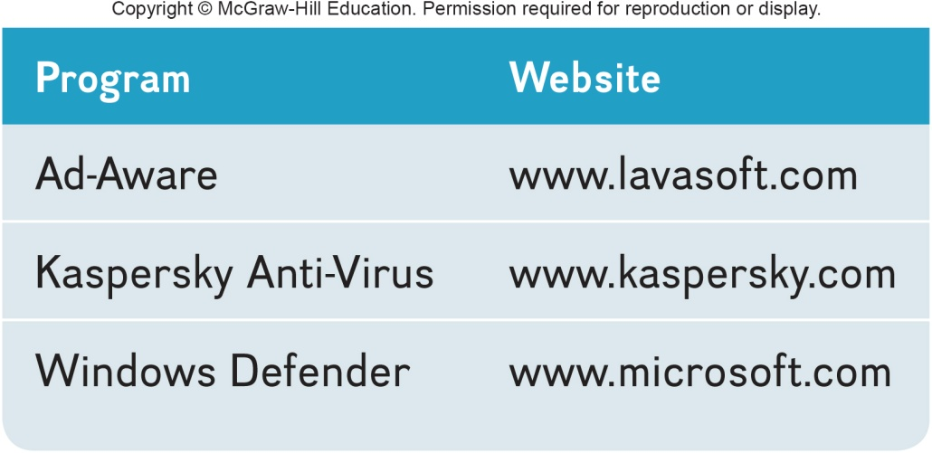
Privacy Threats
Web bugs
Invisible images or HTML code hidden within an e-mail message or web page
When a user opens the message information is sent back to the source of the bug
Spyware
Wide range of programs that are designed to secretly record and report Internet activities, add Internet ad cookies
Computer monitoring software
Invasive and dangerous
Keystroke Loggers
Record activities and keystrokes
Anti-Spyware programs
Detect and remove privacy threats
Notes:
Web bugs (key term) – small programs typically hidden within the HTML code for a Web page or e-mail message and can be used to secretly read e-mail message or work with cookies to collect and report information back to a predefined server on the Web
Spyware (key term) – wide range of programs that are designed to secretly record and report an individual’s activities on the Internet; in addition to Internet Ad cookies, there are also
Computer monitoring software (key term)– invasive and dangerous type of spyware; programs record every activity and keystroke made on a computer system including credit card numbers, bank account numbers, and e-mail messages
Keystroke loggers (key term)– can be deposited on a hard drive without detection from the Web or by someone installing programs directly onto a computer
Anti-Spyware or spy removal programs (key term) - a category of programs known as spy removal programs (key term) – designed to detect Web bugs and monitoring software

Slide 14
Online Identity
The information that people voluntarily post about themselves online
Archiving and search features of the Web make it available indefinitely
Major Laws on Privacy
Gramm-Leach-Bliley Act protects personal financial information
Health Insurance Portability and Accountability Act (HIPAA) protects medical records
Family Educational Rights and Privacy Act (FERPA) resists disclosure of educational records
Notes:
How would you feel if information you posted about yourself on the Web kept you from getting a job?
Online identity (key term) the information that people voluntarily post about themselves online.
There are now major laws on privacy such as:
Gramm-Leach-Bliley Act (key term) which protects personal financial information
Health Insurance Portability and Accountability Act (HIPAA) (key term) which protects medical records
Family Educational Rights and Privacy Act (FERPA) (key term) restricts disclosure of educational records

Slide 15
Security
Involves protecting individuals or organizations from theft and danger
Hackers
Gain unauthorized access with malicious intent
Not all hackers are illegal
Cybercrime / Computer Crime
Criminal offense that involves a computer and a network
Effects over 400 million people annually
Costs over $400 billion each year
Notes:
Security (key term) involves protecting individuals and organizations from theft and danger
People who gain unauthorized access to computers are hackers (key term)
Not all hackers act with malicious intent
Computer crime (key term) cybercrime (key term) - a criminal offense that involves a computer and a network
Computer criminals – those using computer technology to engage in illegal action

Slide 16
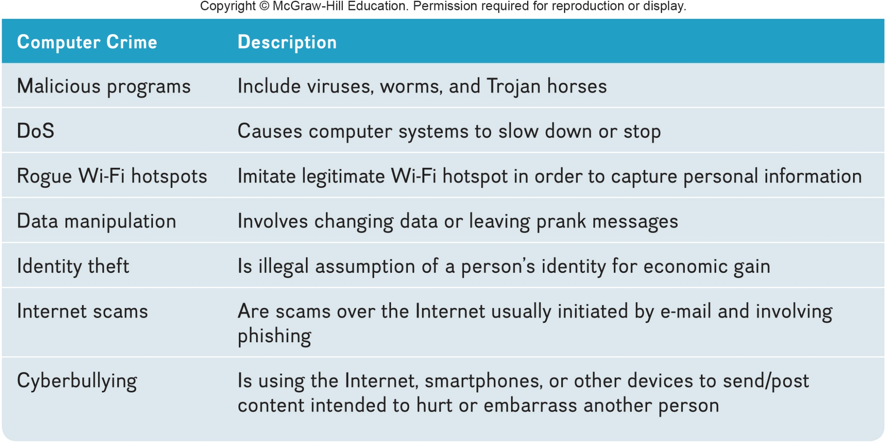
Forms of Computer Crime

Slide 17
Cyber Crime
Denial of Service
(DoS) attack attempts to slow down or stop a computer system or network by flooding it with requests for information or data
Rogue Wi-Fi hotspots
Imitate free Wi-Fi networks and capture any and all information sent by the users to legitimate sites including usernames and passwords
Data manipulation
Finding entry into someone’s computer network and leaving a prankster’s message
Notes:
Denial of service attacks (key term) – attempts to slow down or stop a computer system or network by flooding a computer or network with requests for information and data. The targets of these attacks are usually ISPs.
Rogue Wi-Fi Hotspots (key term) – imitate free Wi-Fi networks and capture any and all information sent by the users to legitimate sites including usernames and passwords.
Data manipulation – finding entry into someone’s computer network and leaving a prankster’s message
Computer Fraud and Abuse Act – law states that it’s a crime for an unauthorized person to view, copy or damage data using any computer across state lines

Slide 18
Internet Scams
A fraudulent or deceptive act or operation to trick someone into providing personal information or spending money for little or no return
Identity Theft
Illegal assumption of someone’s identity for purpose of economic gain
Cyber-bullying
Use of the Internet, cell phones, or other devices to send or post content intended to harm
Phishing
Attempts to trick Internet users into thinking a fake but official-looking website is legitimate
Notes:
Internet scams (key term) –a fraudulent or deceptive act or operation to trick someone into providing personal information or spending money for little or no return
Identity Theft – illegal assumption of someone’s identity for purpose of economic gain
Cyber-bullying (key term) - the use of the Internet, cell phones, or other devices to send or post content intended to hurt or embarrass another person.
sending repeated unwanted emails
ganging up on victims in electronic forums
posting false statements designed to injure the reputation of another
maliciously disclosing personal data about a person that could lead to harm to that person
sending any type of communication that is threatening or harassing
Phishing (key term) attempts to trick Internet users into thinking a fake but official-looking website is legitimate.

Slide 19
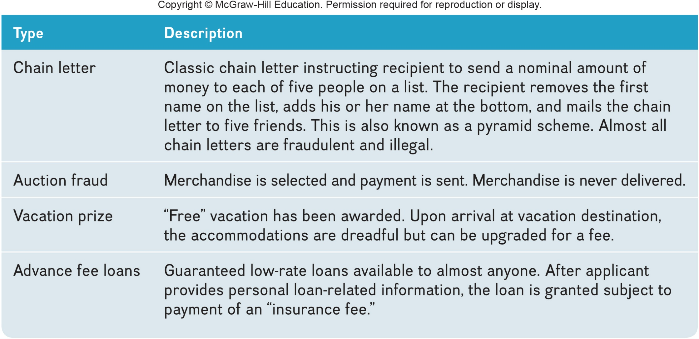
Types of Internet Scams

Slide 20
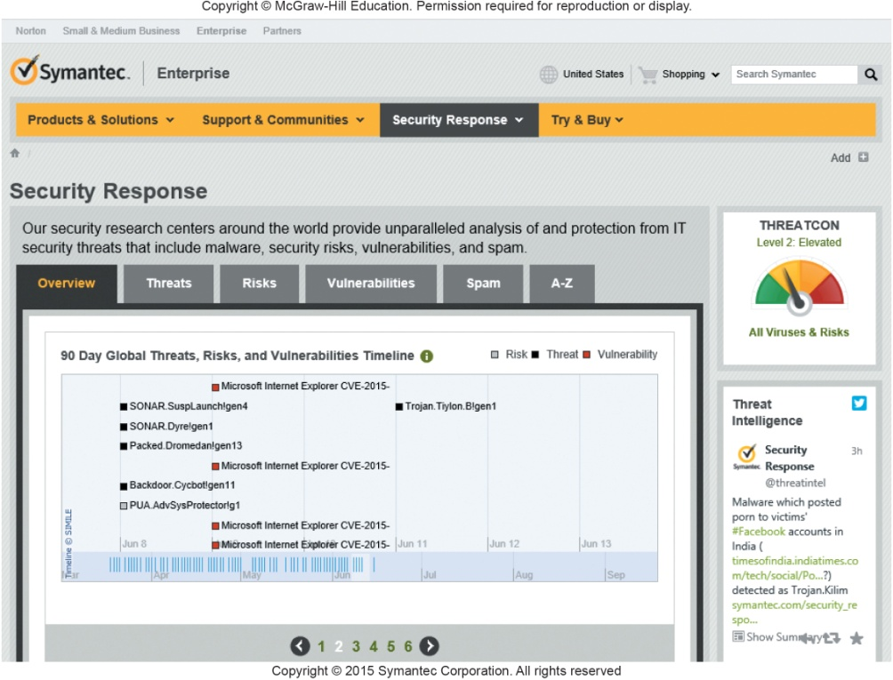
Malicious Software
Malicious Programs or Malware
Designed by crackers, computer criminals, to damage or disrupt a computer system
Computer Fraud and Abuse Act makes spreading a virus a federal offense
3 most common programs
Viruses – migrate through networks and attach to different programs
Worms – fills the computer with self-replicating information
Trojan horse – programs disguised as something else
Notes:
Creation of malicious programs – called malware (key term)which is short for malicious software
Crackers (key term) create and distribute malicious programs
Viruses (key term)–migrate through networks and operating systems and most attach themselves to different programs and databases; can alter and/or delete files; can damage system components;
Computer Fraud and Abuse Act (key term) makes spreading a virus a federal offense
Worms (key term) – a special type of virus
Doesn’t attach to a program
Fills the computer with self-replicating information or can be a carrier of a more traditional virus
Trojan horse (key term) – programs that are disguised as something else; like worms they are carriers of viruses; The most common type of Trojan horses appear as free computer games.
Zombies (key term) – computers infected by a virus, worm, or Trojan horse that allows them to be remotely controlled for malicious purposes
A collection of Zombie computers is knows as a botnet (key term) , or robot network (key term) . Malicious activities include password cracking or sending junk email.

Slide 21
Malicious Hardware
3 most common malicious hardware
Zombies – infected computers allow them to be remotely controlled for malicious purpose.
Rogue WiFi hotspot – imitate free Wi-Fi networks.
Infected USB flash drives – contain viruses and other malicious software
Notes:
Creation of malicious programs – called malware (key term)which is short for malicious software
Crackers (key term) create and distribute malicious programs
Viruses (key term)–migrate through networks and operating systems and most attach themselves to different programs and databases; can alter and/or delete files; can damage system components;
Computer Fraud and Abuse Act (key term) makes spreading a virus a federal offense
Worms (key term) – a special type of virus
Doesn’t attach to a program
Fills the computer with self-replicating information or can be a carrier of a more traditional virus
Trojan horse (key term) – programs that are disguised as something else; like worms they are carriers of viruses; The most common type of Trojan horses appear as free computer games.
Zombies (key term) – computers infected by a virus, worm, or Trojan horse that allows them to be remotely controlled for malicious purposes
A collection of Zombie computers is knows as a botnet (key term) , or robot network (key term) . Malicious activities include password cracking or sending junk email.

Slide 22
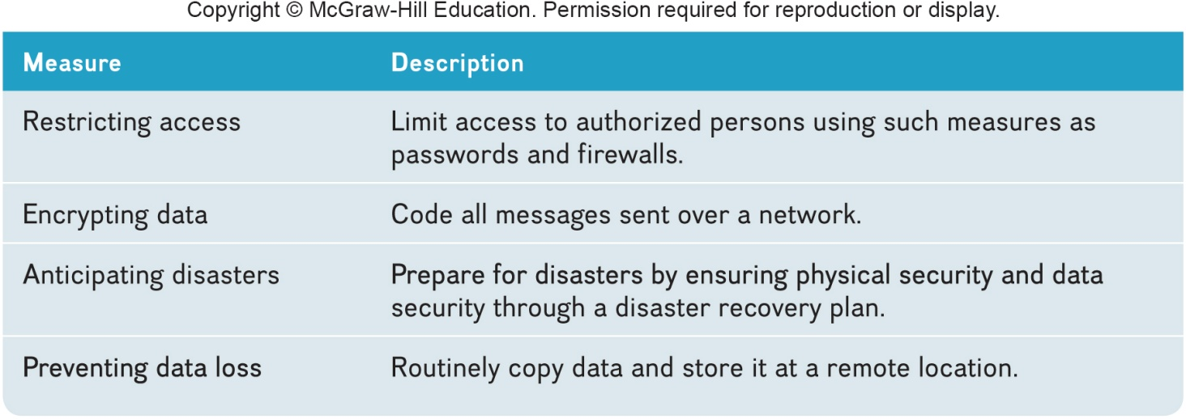
Measures to Protect Computer Security
Principle measures to ensure computer security
Restricting access
Encrypting data
Anticipating disasters
Physical security
Data security
Disaster recovery plan
Preventing data loss
Notes:
Security involves protecting information, hardware, and software from unauthorized use, damage from intrusions, sabotage, and natural disasters
Encryption – coding messages to prevent people from reading your messages

Slide 23
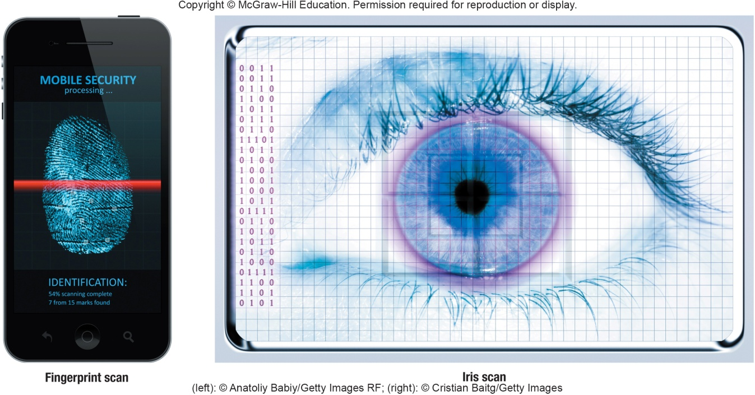
Restricting Access
Firewalls
Authentication
Encrypting Data
Email Encryption
File Encryption
Website Encryption
Biometric scanning
Fingerprint scanners
Iris (eye) scanners
Passwords
Dictionary attack
Uses software to try thousands of common words sequentially to gain unauthorized access to a user’s account
Notes:
Computers should be protected from unauthorized access
Biometric scanning (key term) fingerprint or eye scanners
Passwords (key term)
Change passwords when people leave a company
Dictionary attack (key term) – uses software to try thousands of common words sequentially in an attempt to gain unauthorized access to a user’s account. Words, names, and simple numeric patterns make poor passwords.

Slide 24
Automated Security Tasks
Ways to perform and automate important security tasks
Security Suites
Provide a collection of utility programs designed to protect your privacy and security
Firewalls
Security buffer between a corporation’s provide network and all external networks
Password Managers
Helps to create strong passwords
Notes:
Security Suites (key term) provide a collection of utility programs designed to protect your privacy and security
Firewalls (key term) – a security buffer between a corporation’s private network and all external networks
Password managers – help you create strong passwords

Slide 25
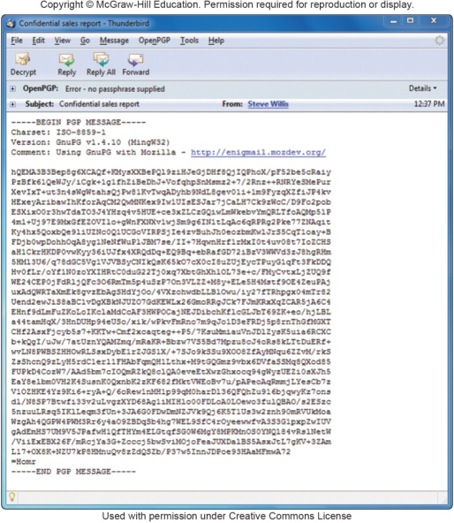
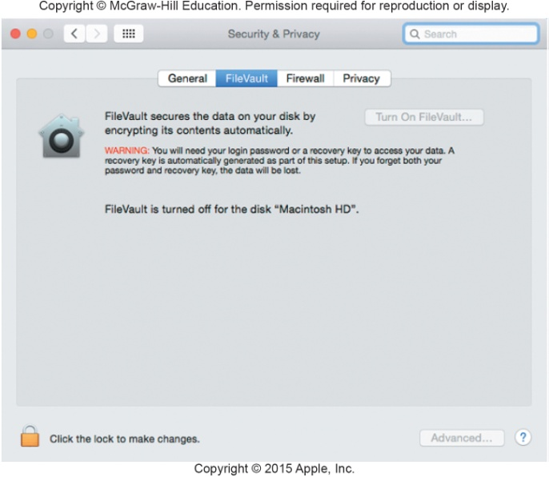
Encryption
Coding information to make it unreadable, except to those who have the encryption key
E-mail encryption protects emails
File encryption protects files
Web site encryption uses HTTPS protocol for protection
HTTPS – hypertext transfer protocol secured
Virtual private networks (VPNs)
Encrypts connects between company networks and their remote users
Wireless network encryption restricts access to authorized users
WPA2 – Wi-Fi Protected Access
Notes:
Encryption (key term) process of coding information to make it unreadable except to those who hold an encryption key (key term) or key (key term) used for decryption
Email encryption protects emails
File encryption protects files
Website encryption
Https(key term) is the most common protocol for website encryption and
VPNs (key term) encrypt connections between company networks and their remote users
Wireless network encryption restricts access to authorized users
WPA2 – Wi-Fi Protected Access (key term)

Slide 26
Anticipating Disasters
Anticipating Disasters
Physical Security protects hardware
Data Security protects software and data from unauthorized tampering or damage
Disaster Recovery Plan describes ways to continue operating in the event of a disaster
Preventing Data Loss
Frequent backups
Redundant data storage
Store off-site in case of loss of equipment
Notes:
Anticipating disasters
Physical security (key term)– protecting hardware
Data security (key term)– protecting software and data from unauthorized tampering or damage
Disaster recovery plan (key term)– describing ways to continue operating until normal computer operations can be restored; can create special emergency facilities called hot sites which are fully equipped backup computer centers or cold sites if hardware must be installed to be utilized
Preventing data loss
Use physical backups – off-site storage using tapes or disks in case of loss of equipment

Slide 27
Recent Data Privacy Trends
Recent trends seek to strike a balance between our data against our privacy.
Cookies-less future - Publishers, advertisers, and Big Tech will need to alter how they monetize their content and gather data in the future.
Consumers demand more control over their data – customers will choose companies that are transparent with their personal data.
Addressing privacy with technology – employ centralize PrivacyOps platform to fulfill users request faster
Public awareness leads to corporate transparency – expect clear data policies.
Governing bodies will enforce more fines.
[https://www.invisibly.com/learn-blog/data-privacy-trends/]
Notes:
Encryption (key term) process of coding information to make it unreadable except to those who hold an encryption key (key term) or key (key term) used for decryption
Email encryption protects emails
File encryption protects files
Website encryption
Https(key term) is the most common protocol for website encryption and
VPNs (key term) encrypt connections between company networks and their remote users
Wireless network encryption restricts access to authorized users
WPA2 – Wi-Fi Protected Access (key term)

Slide 28
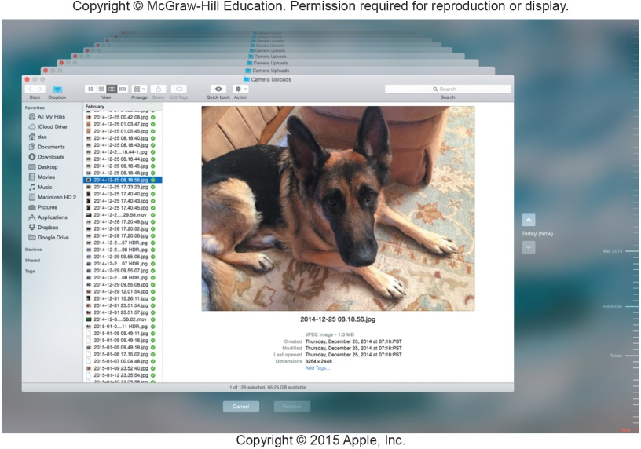
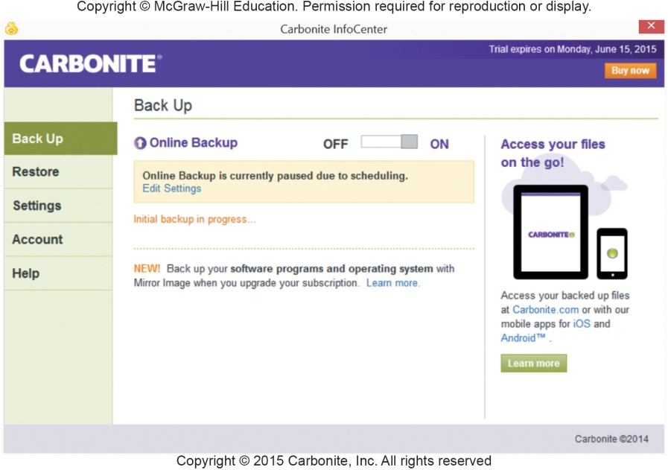
Making IT Work for You ~ Cloud-Based Backup
Cloud-based backup services such as Carbonite provide cloud-based backup services.

Slide 29
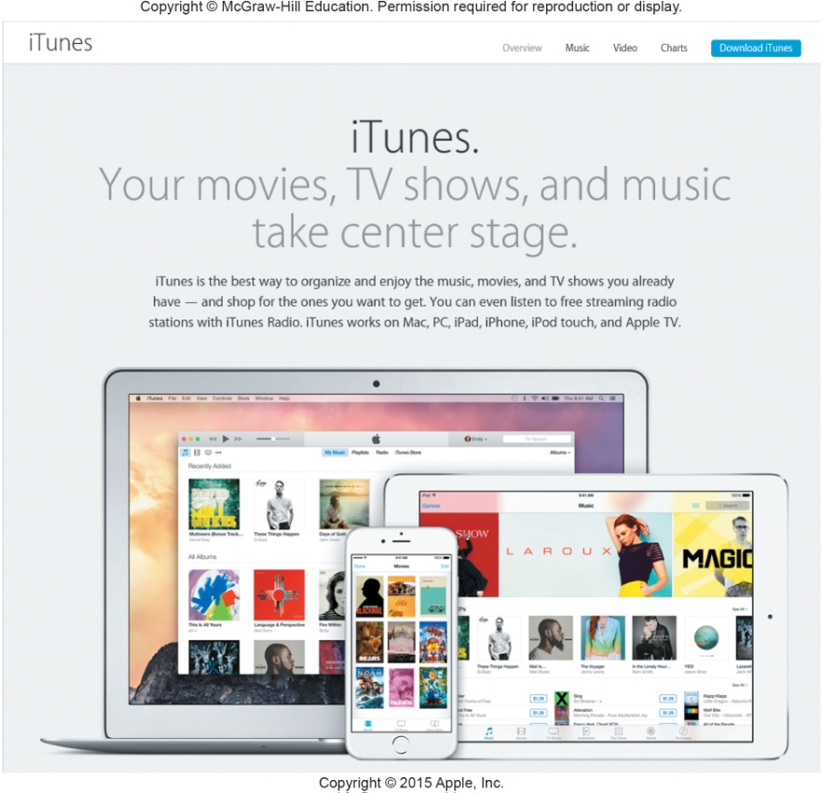
Ethics
Standards of moral conduct
Computer Ethics – guidelines for the morally acceptable use of computers
Copyright
Gives content creators the right to control the use and distribution of their work
Paintings, books, music, films, video games
Software piracy
Unauthorized copying and distribution of software
Digital rights management (DRM) controls access to electronic media
Digital Millennium Copyright Act protects against piracy
Notes:
Technology is moving so fast it is hard for our legal system to keep up. The essential element that controls how computers are used today is ethics (key term)
Computer ethics (key term) - guidelines for the morally acceptable use of computers
Copyright (key term) – legal concept that gives content creators full rights
Software piracy (key term) – unauthorized copying and / or distribution of software
Digital rights management (key term) – prevents copyright violations
Digital Millennium Copyright Act (key term) – illegal to deactivate or disable antipiracy technologies such as DRM

Slide 30

Plagiarism
Representing some other person’s work and ideas as your own without giving credit to the original person’s work and ideas
Notes:
Plagiarism (key term) – representing some other person’s work and ideas as your own without giving credit to the original person’s work and ideas as your own committed by a plagiarist (key term)

Slide 31

Careers in IT
IT Security Analysts maintain the security of a company’s network, systems, and data.
Bachelors or associates degree in information systems or computer science
Experience is usually required
Must safeguard information systems against external threats
Annual salary is usually from $62,000 to $101,000
Demand for this position is expected to grow

Slide 32
Open-Ended Questions (Page 1 of 3)
Define privacy and discuss the impact of large databases, private networks, the Internet, and the Web.
Define and discuss online identity and the major privacy laws.
Define security. Define computer crime and the impact of malicious programs, including viruses, worms, Trojan horses, and zombies, as well as denial of service attacks, rogue Wi-Fi hotspots, data manipulation, identity theft, Internet scams, and cyberbullying.
Notes:
Have students turn to the end of Chapter 9 in their textbooks to view the same “Open-Ended” questions/statements.

Slide 33
Open-Ended Questions (Page 2 of 2)
Discuss ways to protect computer security including restricting access, encrypting data, anticipating disasters, and preventing data loss.
Define ethics, and describe copyright law and plagiarism.
Notes:
Have students turn to the end of Chapter 9 in their textbooks to view the same “Open-Ended” questions/statements.

